Slide 1
CS 4530
Fundamentals of Software Engineering
Module 16: Open Source Principles
Adeel Bhutta, Mitch Wand
Khoury College of Computer Sciences
© 2025 Released under the CC BY-SA license

Slide 2
Learning Goals
By the end of this lesson, you should be able to…
Understand terminology and explain open source culture and principles
Opine on philosophical/political debate between open source and proprietary principles
Reason about tradeoffs of different open source licenses and business model

Slide 3
Background: laws and open source
Copyright protects creative, intellectual and artistic works — including software
Alternative: public domain (nobody may claim exclusive property rights)
Trademark protects the name and logo of a product
OSS is generally copyrighted, with copyright retained by contributors or assigned to entity that maintains it
Copyright holder can grant a license for use, placing restrictions on how it can be used (perhaps for a fee)
Notes:
<read slide>

Slide 4
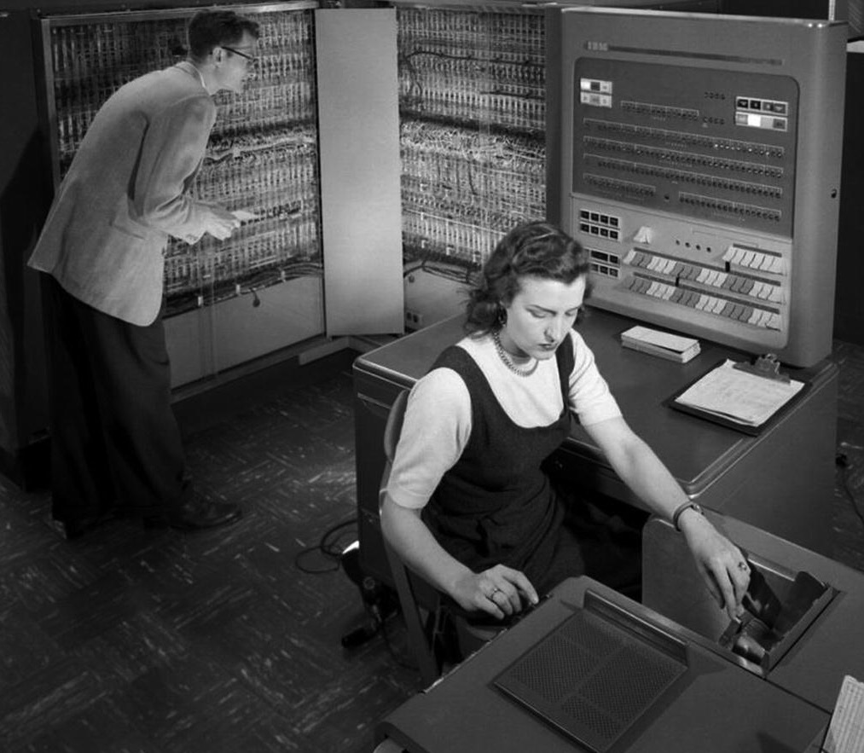
Early open source: UNIX to BSD
Hardware was not yet standardized, computer vendors focused on hardware, building new operating systems for each platform
Much software development focused in academic labs, and AT&T’s Bell Labs
AT&T is prohibited from entering new telecommunications businesses (can’t make OS a product)
Unix created at Bell Labs using the new, portable language “C”, licenses initially released with source code
1978: UC Berkeley begins distributing their own derived version of Unix (BSD)
IBM 704 at NASA Langley in 1957 (Public domain)
Notes:
HW not standardized -> OS’ were written in assembly (no higher level language was efficient enough, and hardware was too slow).
Academic -> already have culture of open science
Bell labs -> 1949 US DOJ starts antitrust investigations into ATT (who at the time owned every single aspect of the phone system from the device in your home to the wires in your wall to the wires on the street, across the country, switching equipment, etc - no other providers involved), 1956 US enters Korean War and DOJ and ATT agree on a “consent decree” to end the investigation and help ATT focus on war effort. Consent decree said that ATT couldn’t enter new telecommunications businesses. As a result, ATT determines that they could not “pursue software as a business” and they ended up needing to release the source code with the operating system so that end-users could implement bug fixes etc. on their own (no ability to do service contracts).

Slide 5
The BSD License is Permissive
Authors of BSD created a license for the OS that:
Required those using it to credit the university (in source, doc, ads)
Limited liability for (mis)-use
Copyright (c) <year>, <copyright holder> All rights reserved.
Redistribution and use in source and binary forms, with or without modification, are permitted provided that the following conditions are met:
Redistributions of source code must retain the above copyright notice, this list of conditions and the following disclaimer.
Redistributions in binary form must reproduce the above copyright notice, this list of conditions and the following disclaimer in the documentation and/or other materials provided with the distribution.
All advertising materials mentioning features or use of this software must display the following acknowledgement: This product includes software developed by the <copyright holder>.
Neither the name of the <copyright holder> nor the names of its contributors may be used to endorse or promote products derived from this software without specific prior written permission.
THIS SOFTWARE IS PROVIDED BY <COPYRIGHT HOLDER> AS IS AND ANY EXPRESS OR IMPLIED WARRANTIES, INCLUDING, BUT NOT LIMITED TO, THE IMPLIED WARRANTIES OF MERCHANTABILITY AND FITNESS FOR A PARTICULAR PURPOSE ARE DISCLAIMED…. (move waivers of liability)
Original BSD license
BSD Copyright in OS X boot sequence
Notes:
The authors of BSD constructed a license that they attached to the OS when they released it, called the BSD license. The license has two main effects: 1. it requires that those using it credit the university (in source code, in documentation, and in advertising!!!). This has the effect of, for example, when using software derived from BSD (like Mac OS X!) you’ll randomly see copyright notices attributed to the regents of the university of California. And, 2: it limits the creator’s liability – if a BSD product explodes on you, you are not allowed to sue the creators.
<Discuss: how much of a restriction is this? What might be good/bad about it?>

Slide 6
UNIX to GNU’s Not Unix
Timeline
1978: UC Berkeley begins distributing their own derived version of Unix (BSD)
1983: AT&T broken up by DOJ, UNIX licensing changed: no more source releases
Competing commercial vendors all package and sell their derivations of UNIX (AT&T, HP, Sun, IBM, SGI)
Also 1983: Richard Stallman announces “Starting this Thanksgiving I am going to write a complete Unix-compatible software system called GNU (Gnu’s Not Unix), and give it away free to everyone who can use it”
GNU logo (a gnu wildebeest)
Notes:
1983 - Everything was pretty peach with AT&T’s Unix being used and improved in academia until 1983… when DOJ settled a new antitrust case against ATT, ATT then breaks up into the “baby bells” (regional operating companies like bell Atlantic; most of these are now verizon), meaning the ATT can now commercialize UNIX, which they do.
While the academics took their ATT UNIX license and created BSD, the suits at HP, Sun, IBM, and SGI all took their original UNIX license and created *their own* derived version of UNIX.
Some people looked at the state of affairs at the time and were concerned that this fragmentation would destroy any collective open-source efforts: Sun, HP, IBM, SGI et al are going to stop releasing the source of their derived UNIX OS, and will innovate in secret.
So, a character in our story named “Richard Stallman” then declares that he will solve this problem by re-writing a UNIX-compatible (but NOT UNIX) system from scratch that is

Slide 7
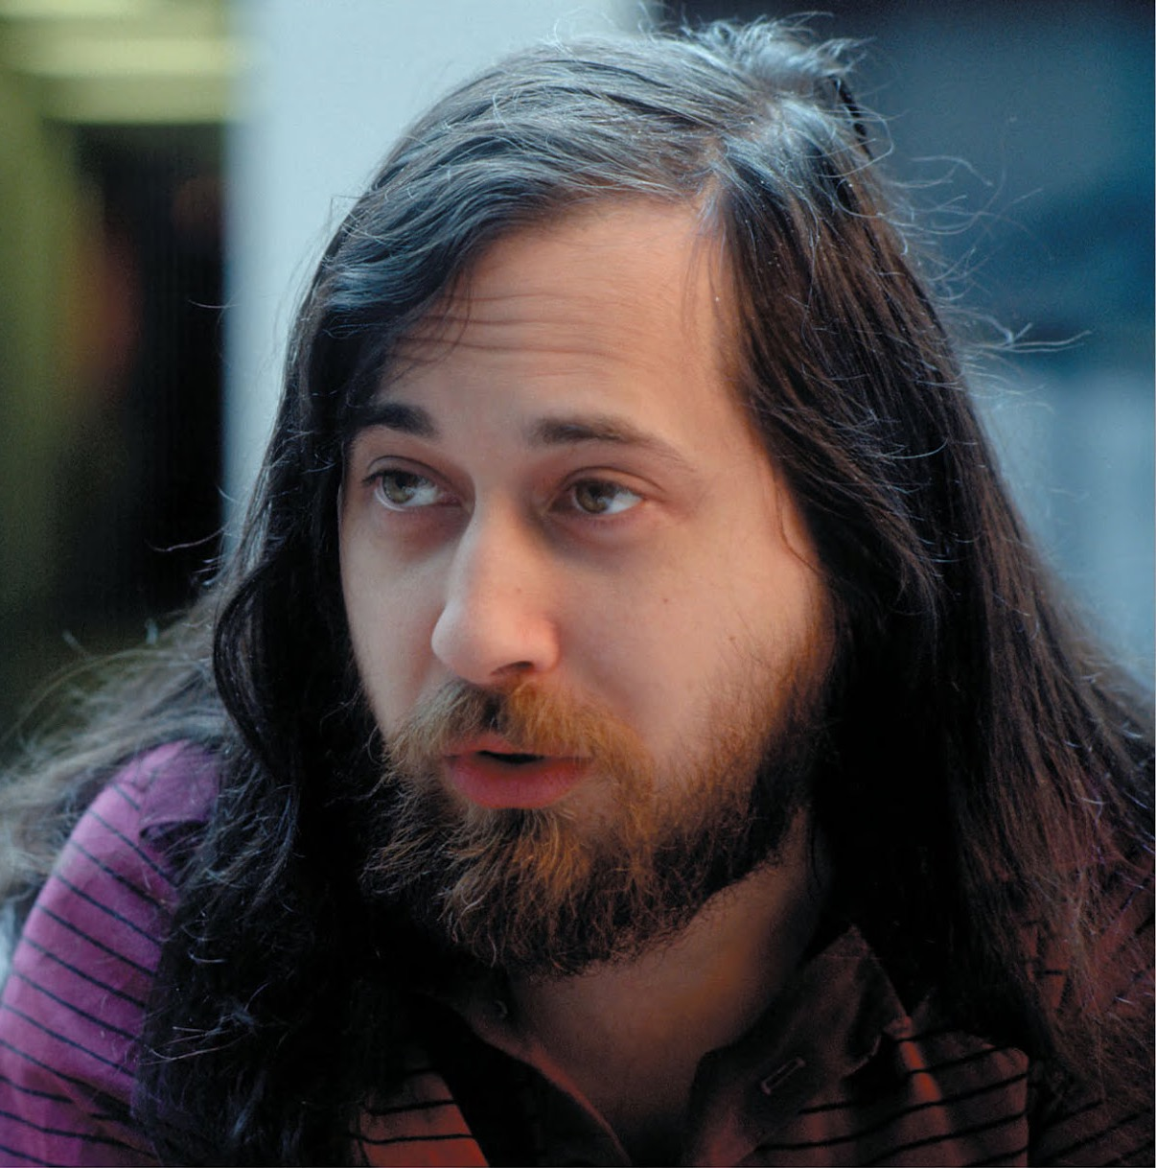
Free software as a Philosophy
“Free as in Speech, not as in beer”
Richard Stallman’s Free Software Foundation — free as in liberties
Freedom 0: run code as you wish, for any purpose
Freedom 1: study how code works, and change it as you wish
Freedom 2: redistributed copies (of original) so you can help others
Freedom 3: distribute copies of your modified version to others
Richard M Stallman (Licensed under GFDL)
Notes:
An interesting and important outcome of this fracture was Stallman’s writings and creation of the free software foundation, which holds fast to these principles of software liberties..
(read slide)
Discuss: how is it possible to actually build a product and follow these freedoms? What is there to stop someone from taking your software, improving it, and selling it? (Next slide describes the “fix” for this with copyleft)
Discuss: What kind of person is RMS for starting the freedoms with 0?

Slide 8
Copyleft v. permissive
Freeware Licenses “Do whatever you want with this software, but don’t blame me if it doesn’t work” usually fall into two categories:
Permissive licenses (BSD, MIT, Apache) encourage adoption by permitting combining OSS with my product, releasing my product under a different license (perhaps not even OS)
Copyleft (GPL) “protects the commons” by having all linked code under same license, transitively requiring more sharing
Philosophy: do we force participation, or try to grow/incentivize it in other ways?
Notes:
Discuss: what are the benefits to each approach?

Slide 9
GNU/Linux (1991-Today)
Stallman set out to build an operating system in 1983, ended up building utilities needed by an operating system (compiler, etc)
Linux is built around and with the GNU utilities, licensed under GPL
Rise of the internet, demand for internet servers drives demand for cheap/free OS
Companies adopted and support Linux for enterprise customers
IBM committed over $1B; Red Hat and others
Notes:
In the 90’s you COULD download linux for free, but what was even more popular was sending away for it on disks, paying only for the cost of the disks themselves and postage - think $6 instead of $150 for windows

Slide 10
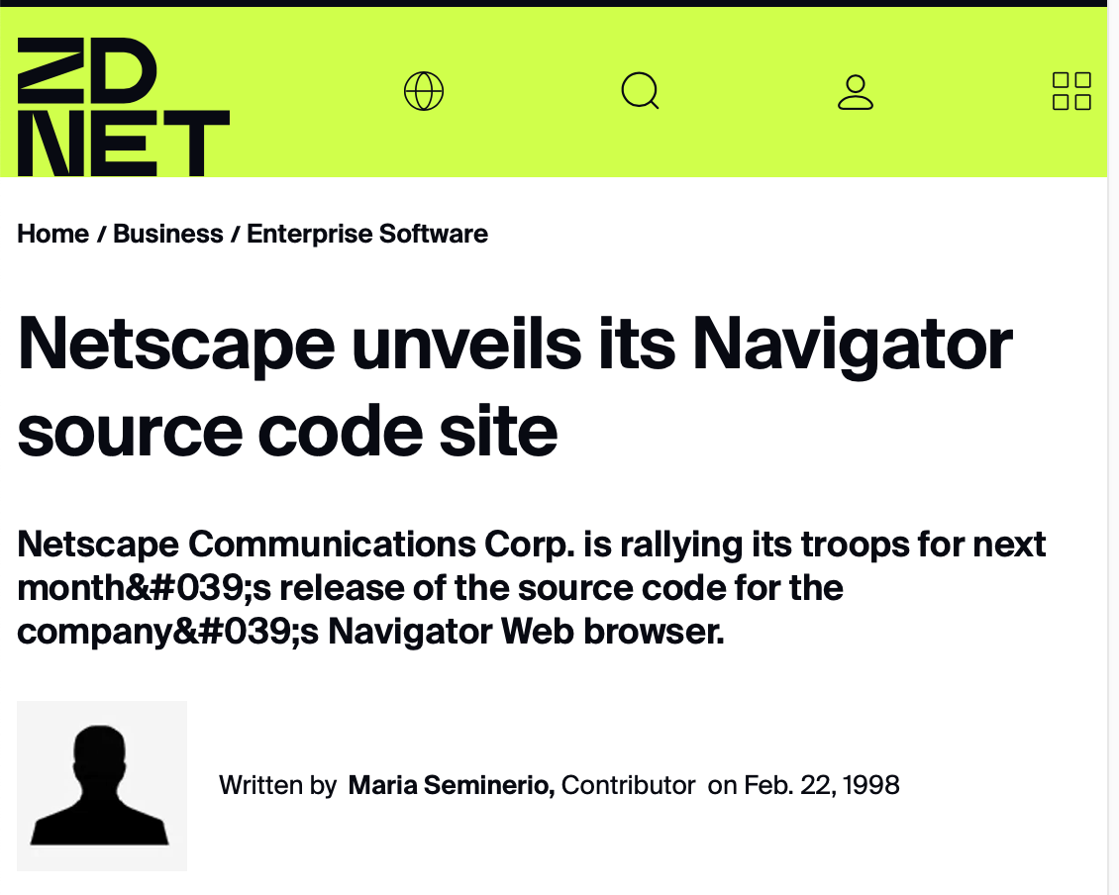
Netscape’s open-source gambit
Netscape was dominant web browser early 90’s
Business model: free for home and education use, companies pay
Microsoft entered browser market with Internet Explorer, bundled with Windows95, soon overtakes Netscape in usage (free with Windows)
January 1998: Netscape first company to open source code for proprietary product (Mozilla)
Usage Share of Netscape Navigator
Notes:
Lots of interesting details about netscape’s decision and process here - https://www.oreilly.com/openbook/opensources/book/netrev.html . Perhaps most interesting to discuss is the process around deciding the license (they used a public, somewhat democratic process to determine what licensing constraints should be). The vision was truly to “collaborate” with everyone building and using the web, rather than to try to create a singular ideal product (which is what they had previously been doing, and Microsoft beat them at)
Netscape did not call this open source!!!! They released a public website with their source code (“open source” was not yet coined)

Slide 11

Netscape creates a new license and model
Until Netscape, much of OSS was the FSF and its GPL
Open Source coined in 1998 by the Open Source Initiative to capture Netscape’s aim for an open development process
New licenses follow, e.g. MIT, Apache, etc. just like BSD, but without the advertising part
Publisher Tim O’Reilly organizes a Freeware Summit later in 1998, soon rebranded as Open Source Summit
Open Source is a development methodology; free software is a social movement — Richard Stallman
Open source initiative logo
Tim O’Reilly Photo via Christopher Michel/Flickr, CC BY 2.0
Notes:
Netscape was released under “Netscape Public License” which was similar to the GNU General Public License but allowed Netscape to continue to publish proprietary work containing the publicly released code.
Coining and protecting the term “open source” was a big deal for getting to the open source that we know of today. (Slide largely explains how term was coined, focusing on last quote might provide good opportunities for discussion).
Discussion ideas:
Stallman’s quote comes from an essay titled “Why Open Source Misses the Point of Free Software” - do you think that the proponents of open source did this intentionally (the answer is yes: they want something that was a development methodology that could be seen as palatable and adopted by businesses, governments, and those who may not agree with the social movement)
These movements are clearly motivated by the backgrounds and goals of their founders. Tim O’Reilly is a book publisher. Richard Stallman is an anarchist hacker (his direct quote is that it combines aspects of capitalism, communism and anarchism).

Slide 12
Firefox lost battle, Open Source wins war
Firefox lost to Chrome and Safari, but OSS won
Chrome’s core = Chromium OSS
Safari’s core = Webkit OSS
Microsoft’s Edge core = Chromium
How do browsers differentiate?
Why is there more than one?
[By Datavizzer, CC BY-SA 4.0]
Notes:
"Chromium" refers to an open-source project by Google that includes its own rendering engine called "Blink," while "WebKit" is a separate rendering engine primarily used by Apple's Safari browser, which Chromium does not directly use;
Blink is a fork of WebKit (rendering engine)

Slide 13
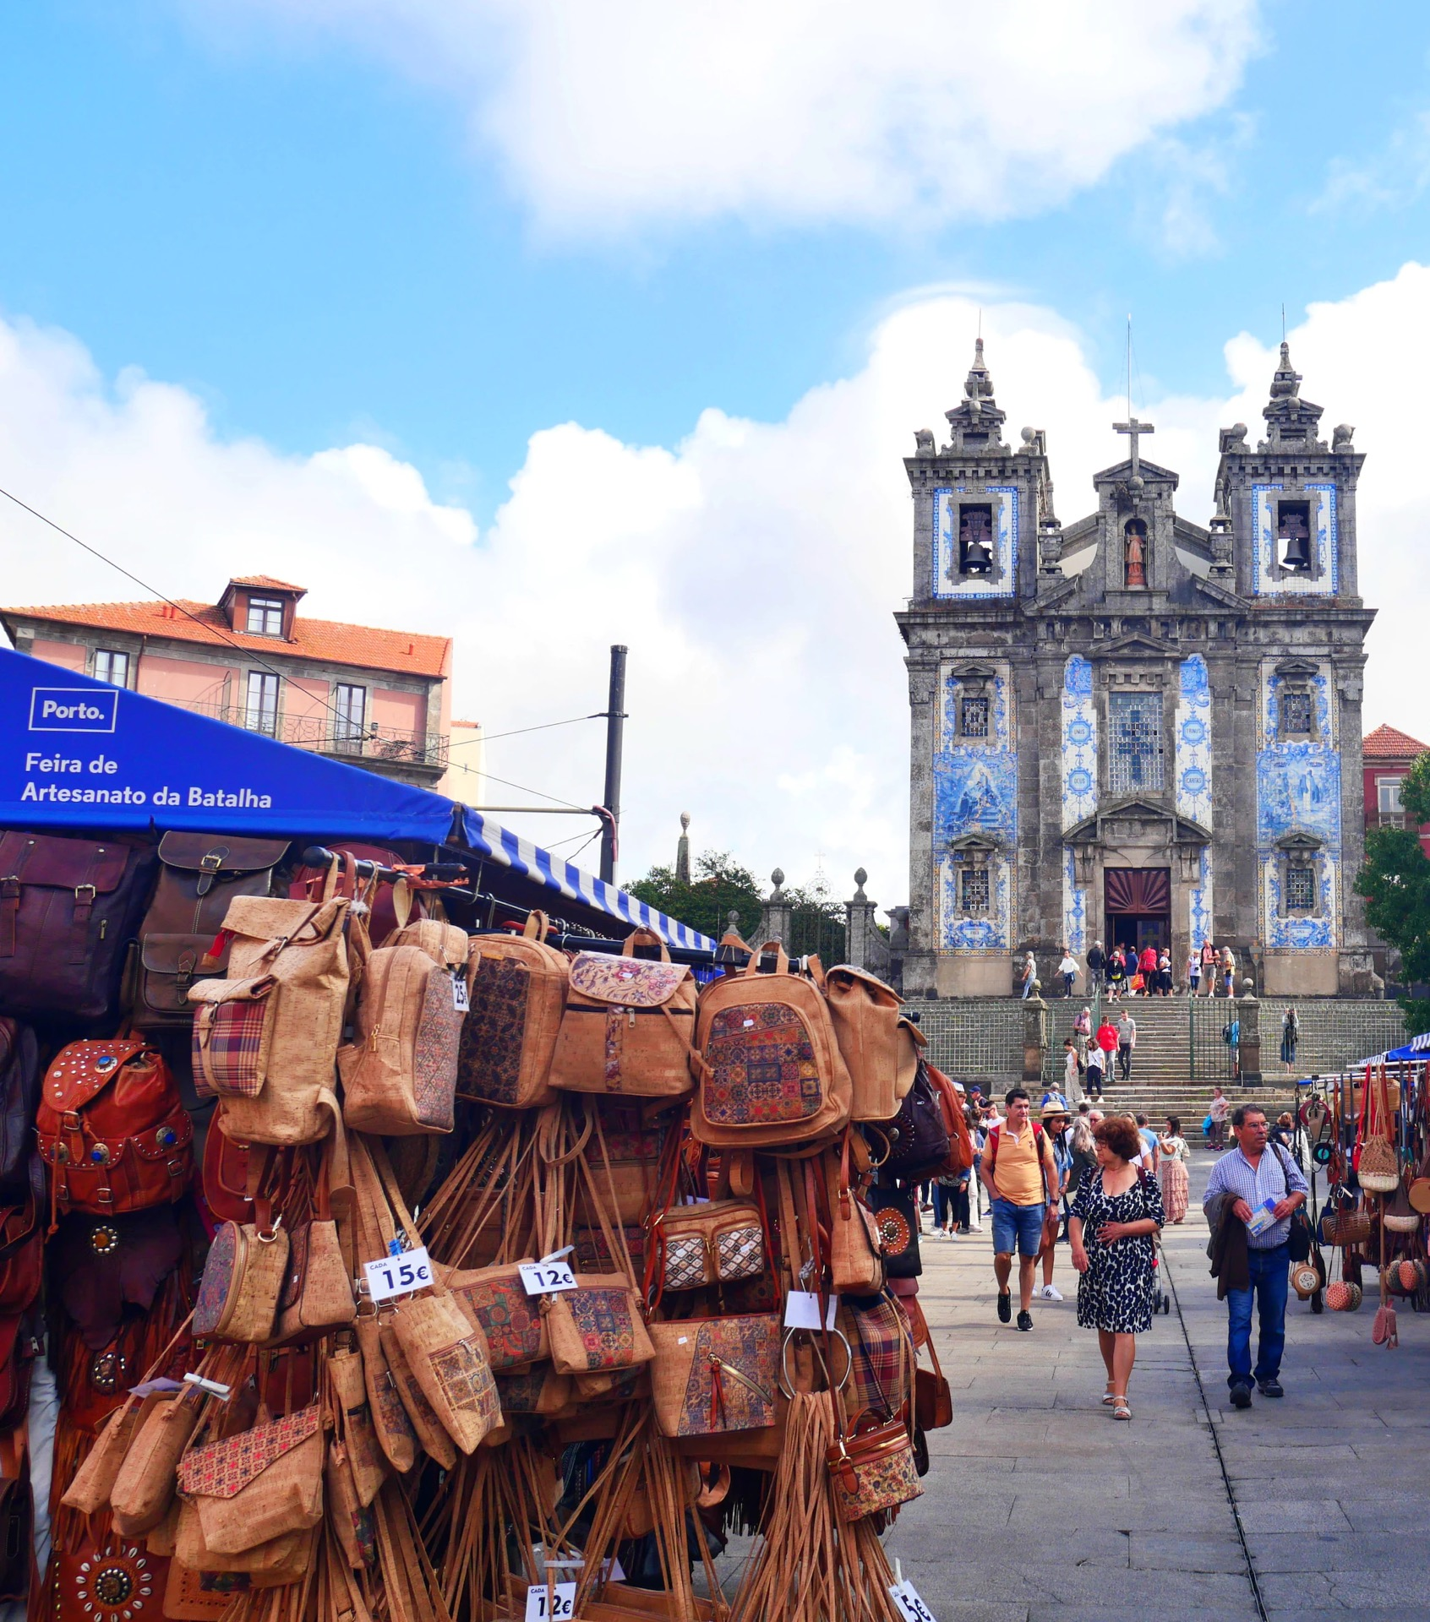
OSS Provides Community Infrastructure
Operating Systems are a utility for the common good: everybody needs them, nobody wants to bear the cost
Eric S Raymond’s 1997 essay compares software development methodologies as a “cathedral” or “bazaar”
Much OSS today follows “bazaar” model:
Users treated as co-developers
Release software early for feedback
Modularize + reuse components
Democratic organization
Notes:
Part of Linux’s successes and growth in the 90’s is captured in Eric S. Raymond’s 1997 essay “The cathedral and the bazaar”
Cathedral (closed source) - Top-down design with focus on planning
Bazaar (open source)
Organic bottom-up movement
Code always public over internet

Slide 14
GitHub is the Modern Bazaar
XKCD “Dependency”

Slide 15
Adopting OSS has risks
Are licenses compatible?
Including permissive-licensed software in copyleft-licensed software is generally compatible (copyleft takes precedence)
A significant concern for licenses with copyleft: Adopting libraries with copyleft clause generally means what you distribute must also have same copyleft clause (and be open source)
Are you certain that the software truly is released under the license that is stated? Did all contributors agree to that license?
Notes:
The problem of “is the software really released under that license” is what exposed Google to Oracle’s suit
Note that we are not discussing software patents because that would be another lecture :)

Slide 16
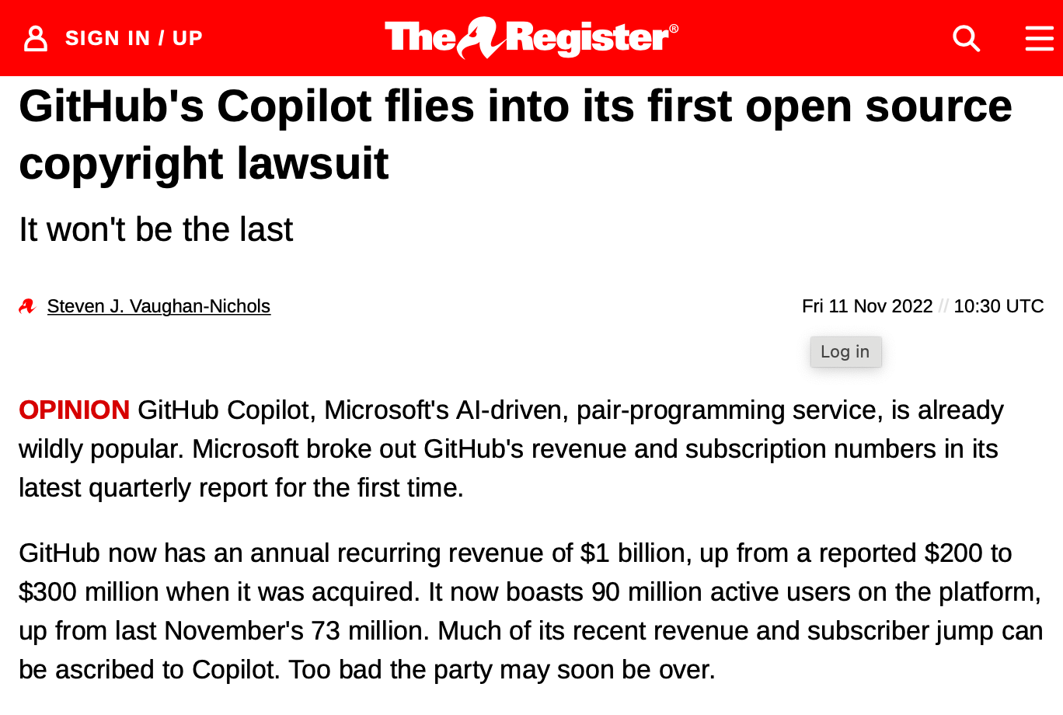
OSS Risks: GitHub Copilot and Codex
Codex is a large language model trained on code in public repositories on GitHub
Copilot suggests lines of code as you program, based on the Codex model
Copilot will output entire snippets of code from public GitHub repositories
What is the ownership and license compatibility of the resulting code?
https://www.theregister.com/2022/11/11/githubs_copilot_opinion/
Notes:
MS’ defense is that this is “fair use” under copyright law… if it is, it will set quite the precedent for copyright of software.

Slide 17
Successful OSS have strong communities
OS projects thrive when community surrounding them contributes to push the project forward
Communities form around collective ownership (even if it’s only perceived)
Contributors bring more than code: also documentation, support, and outreach
Community/ownership models:
Corporate owner, community outreach/involvement (MySQL, MongoDB)
Foundation owner, corporate sponsors (GNU, Linux)

Slide 18
Open Source Governance
Some OSS projects are managed by for-profit firms
Examples: Chromium (Google), Moby (Docker), Ubuntu (Canonical), TensorFlow (Google), PyTorch (Meta), Java (Oracle)
Contributors may be a mix of employees and community volunteers
Corporations often fund platforms (websites, test servers, deployments, repository hosting, etc.)
Corporations usually control long-term vision and feature roadmap
Many OSS projects are managed by non-profit foundations or ad-hoc communities
Examples: Apache Hadoop/Spark/Hbase/Kafka/Tomcat (ASF), Firefox (Mozilla), Python (PSF), NumPy (community)
Foundations fund project infrastructure via charitable donations
Long-term vision often developed via a collaborative process (e.g., Apache) or by benevolent dictators (e.g., Python, Linux)
Business models can support both governance models
Notes:
Discuss benefits/risks of different models:
Corporate ownership
Easier to set a vision/strategy/path
Might lose the community support
Needs to provide some financial benefit to company
Foundation ownership
Organization of foundation might influence how hard it is to make decisions: consider benevolent dictator for life (e.g. Guido Von Rossum + Python; Larry Wall + Perl) vs democracy
Needs to find some way to keep community engaged (or it falls apart)

Slide 19
Contributing to open source projects
Mature OSS projects often have strict contribution guidelines
Look for CONTRIBUTING.md or similar
Common requirements:
Coding style (recall: linters) and passing static checks
Inclusion of test cases with new code
Minimum number of code reviews from core devs
Standards for documentation
Contributing licensing agreements
Without this, you own the copyright and IP for even small bug fixes and that can cause them legal headaches in the future

Slide 20
When communities move on: Forks
The only rights an OSS creator can realistically retain are trademarks on name
Code will be forked
Example:
1999: Sun buys StarOffice, GPL’ed as OpenOffice to fight MS Office
2010: Oracle buys Sun, fires internal developers, frustrating community
2011: Community fork it as LibreOffice, OpenOffice dies (Oracle gifts it to Apache)
Notes:
Sun paid $60M to buy star office, supposedly “it was cheaper to buy star office than to license MS office for all 42,000 employees at sun who needed it”
LibreOffice was heralded as “an effort to duplicate the strategy used by Netscape’s Mozilla open-source spinoff”

Slide 21
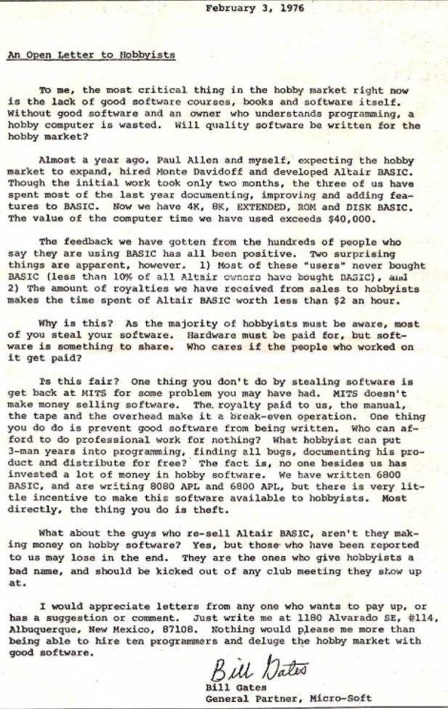
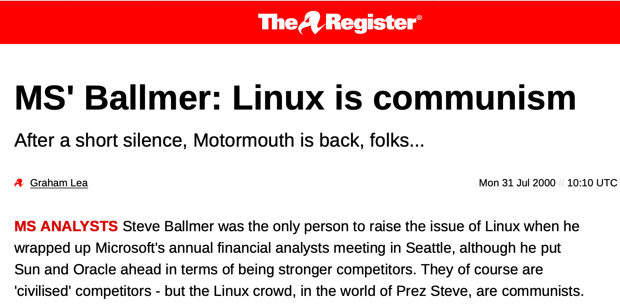
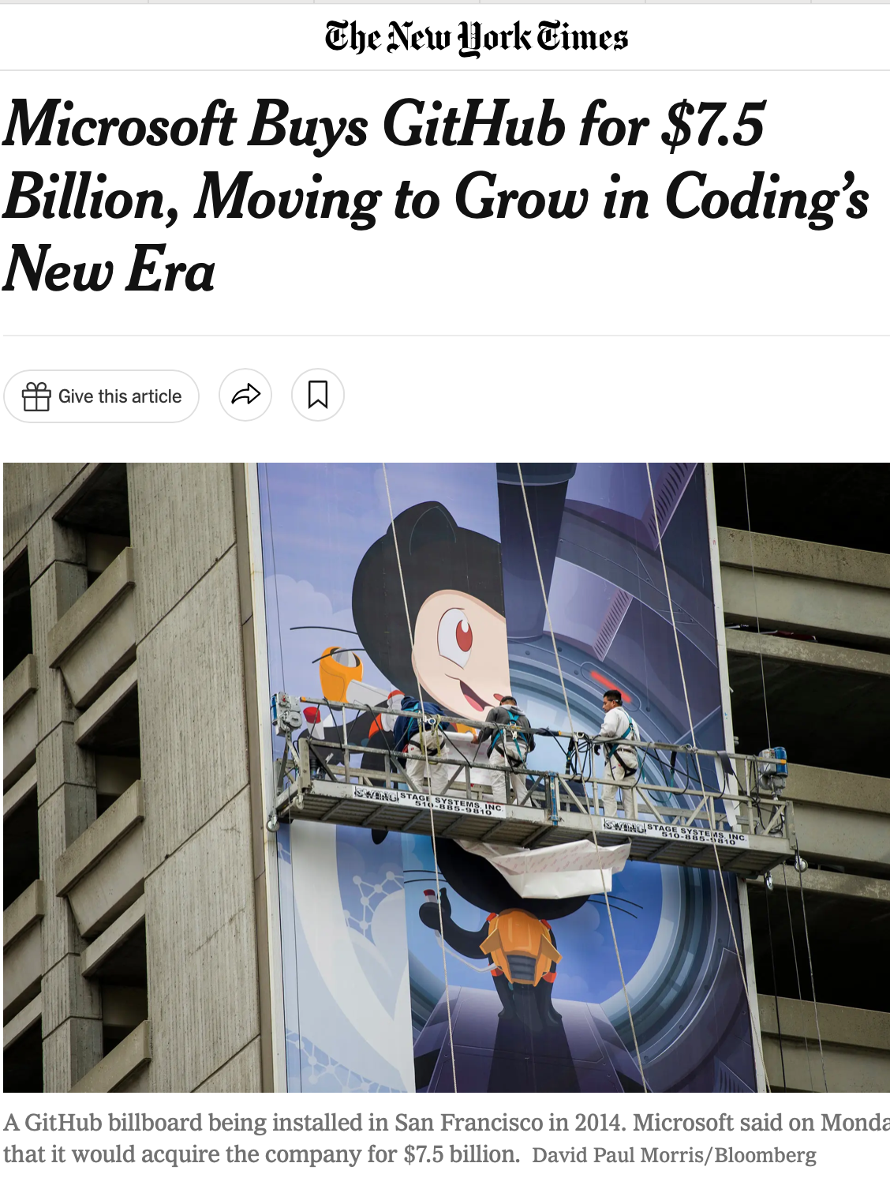
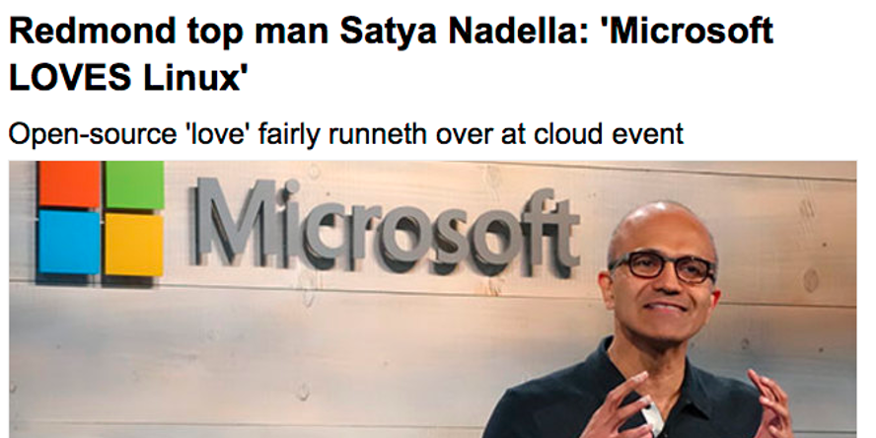
Is Open Source a business model?
Notes:
As we’ll discuss in this lecture, there is no single answer to the question “is open source a good business model”, and instead, it is probably more useful to talk and think about different contexts and different business models - and then think about the role of open source in that business.
As a teaser to indicate how the role of open source in software development can shift over time:
In 1974 Bill Gates wrote an infamous open letter to hobbyists who were using his Altair 8800 BASIC interpreter without a license. They were stealing his software, and it didn’t work with the business model of micro-soft.
Cut to 2000, when in an earning’s call, the then-CEO Steve Ballmer stated that it had “the characteristics of communism that people love so very, very much”
Cut to 2014, when Microsoft’s new CEO announces that “Microsoft LOVES Linux” and starts invest in it. And 2018 when for 7.5b they bought GitHub, plus much more.
There is, perhaps, some way to do this right and many to do it wrong.

Slide 22
“Open Source as a Utility” is a common model
The largest, most successful open source projects implement utility infrastructure:
Operating systems, web servers, logging libraries, programming languages
Business model: build and sell products and services using those utilities, contribute improvements back to the ecosystem
Linux, Kubernetes, React, etc.
Many companies provide specialized distributions of these open source infrastructure and specialized tools to improve them; support upstream project
Notes:
Example: bank needs to have servers, bank might need to have linux. Does bank have staff to support and patch linux, or do they pay someone for a service contract? They pay Red Hat (recently purchased by IBM, about 20 years after that ad was made).
We all love and hate Java; we probably use IDEs from JetBrains ,who also is involved in the ongoing maintenance of java, and created the JVM-compatible language, kotlin
Discussion: Are there other projects that you can think of that are open source, and not really what the company who created them does? How do those companies (in)directly profit from this?
React (Facebook is a social network, but created and maintains an app toolkit) - profits from apps that integrate with their network
Square, many other small-ish tech companies open source their dev tools and libraries - helps with recruiting?

Slide 23
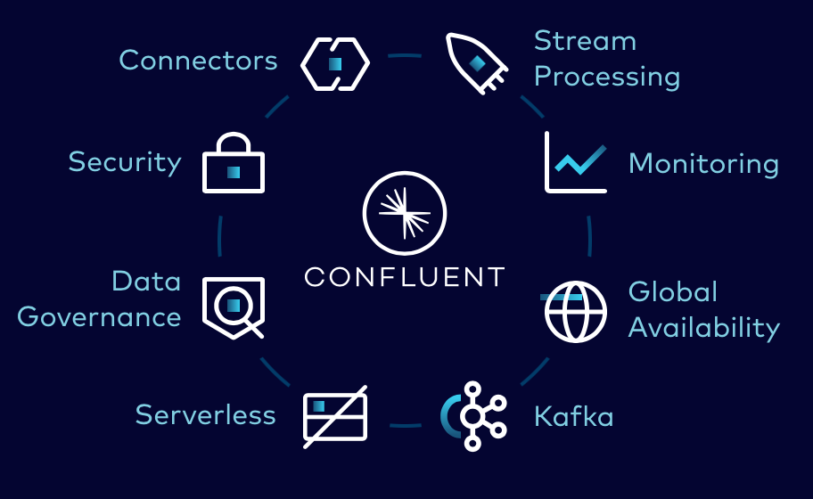
Monetize OSS with “open core, closed plugins”
Model: core component of product is open source; plugins for a fee
Example: Apache Kafka, a distributed message broker (glue in event-based system)
Product is open source, maintained by Apache foundation, supported by a company
Confluent provides plugins to connect Kafka to different systems out-of-the-box
[Screenshot: “Apache Kafka vs Confluent”]

Slide 24
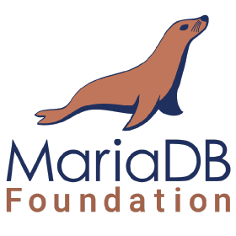
Monetize OSS with dual licenses (?)
Model: Offer a free copyleft license to encourage adoption, prevent competitors from improving it without sharing improvements.
Offer custom, more permissive licenses to third parties willing to pay for that (needed to bundle MySQL with a proprietary system)
Only possible when there is a single copyright owner, who can unilaterally change license
Risk of losing control of the copyleft portion: nothing to stop the community from forking it (MySQL – MariaDB)
Notes:
This approach runs into interesting philosophical questions:
From the FSF perspective: it is immoral to contribute to mysql, because mysql will profit from your contribution
Is this the kind of democratic “bazar” that we started with, or is it just a facade of “real” open source?
When Oracle bought MySQL (as part of buying Sun), the community fractured and created MariaDB, a fork of MySQL that is released under GPL (nothing in GPL to stop that from happening, it’s kinda the point of GPL)

Slide 25
Monetize OSS by selling it as a SaaS (?)
Model: Creators of OSS provide a cloud hosted, “fully managed” installation as a service
Risk: What is your competitive advantage over cloud utility providers?
Amazon improves your GPL code without sharing because it is not distributing it (operates it as a service)
Example: MongoDB Atlas (document-oriented database)
MongoDB created a new copyleft license for providers operating MongoDB as a service
Amazon forked GPL’ed MongoDB

Slide 26

Monetize OSS by offering title insurance
SQLite is an extremely popular database library, in the public domain (copyright is waived)
License text:
The author disclaims copyright to this source code. In place of a legal notice, here is a blessing:
May you do good and not evil.
May you find forgiveness for yourself and forgive others.
May you share freely, never taking more than you give.
To have legal proof that the code is in the public domain (traceable links from code to waivers of copyright), you pay money
Notes:
<read slide>

Slide 27
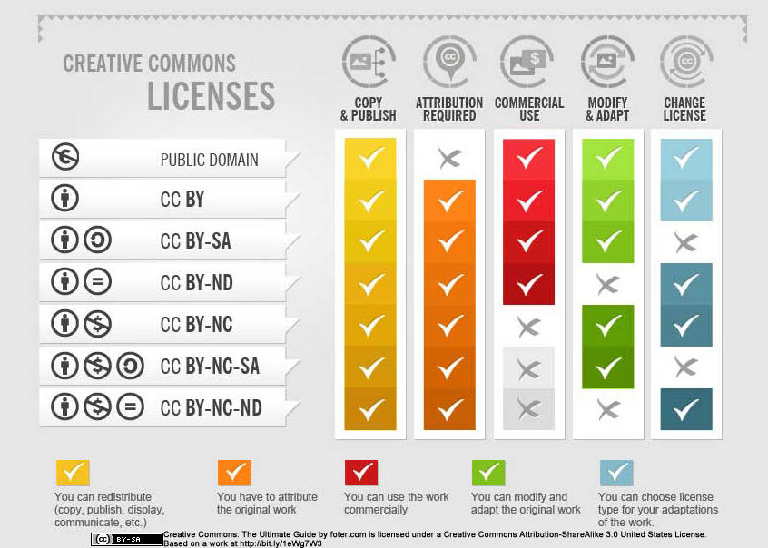
Other Licenses
https://creativecommons.org/share-your-work/cclicenses/
Notes:
<Read slide>
Explore more options

Slide 28
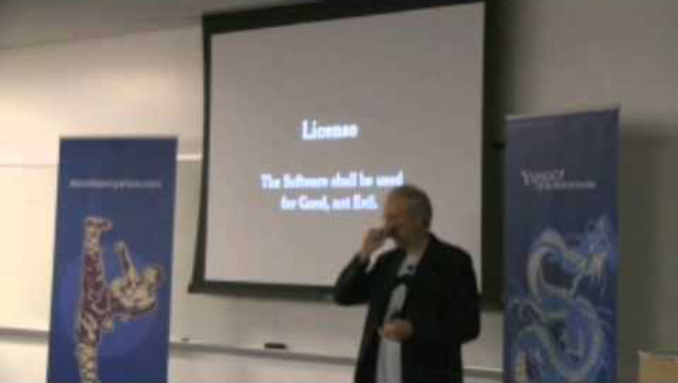
Other philosophies are expressed in some licenses
Notes:
Remember how the SQLite license had a *blessing* “May you do good not evil?”
Some people try to be a bit more outright, like: “You can not use this software for evil.” Here’s a clip from the guy that created JSON (and JSLint, a popular tool used by everyone to validate JSON)

Slide 29
Learning Goals
You should be able to…
Understand terminology and explain open source culture and principles
Opine on philosophical/political debate between open source & proprietary principles
Reason about tradeoffs of different open source licenses and business model

